Slide 1

Kingston Grants Program
2024-2025
Information Session
Notes:
Clarify that this session is about funding from Kingston Council, not other bodies such as State or Federal Government

Slide 2
Introducing Kingston’s Grants Team
Kingston’s Grants Team:
Gillian Turnbull, Community Capacity Coordinator
Kath Scarpella, Kingston Grants Officer
Rachael Hurley, Kingston Grants Officer
Ph: 1300 653 356
community@kingston.vic.gov.au

Slide 3
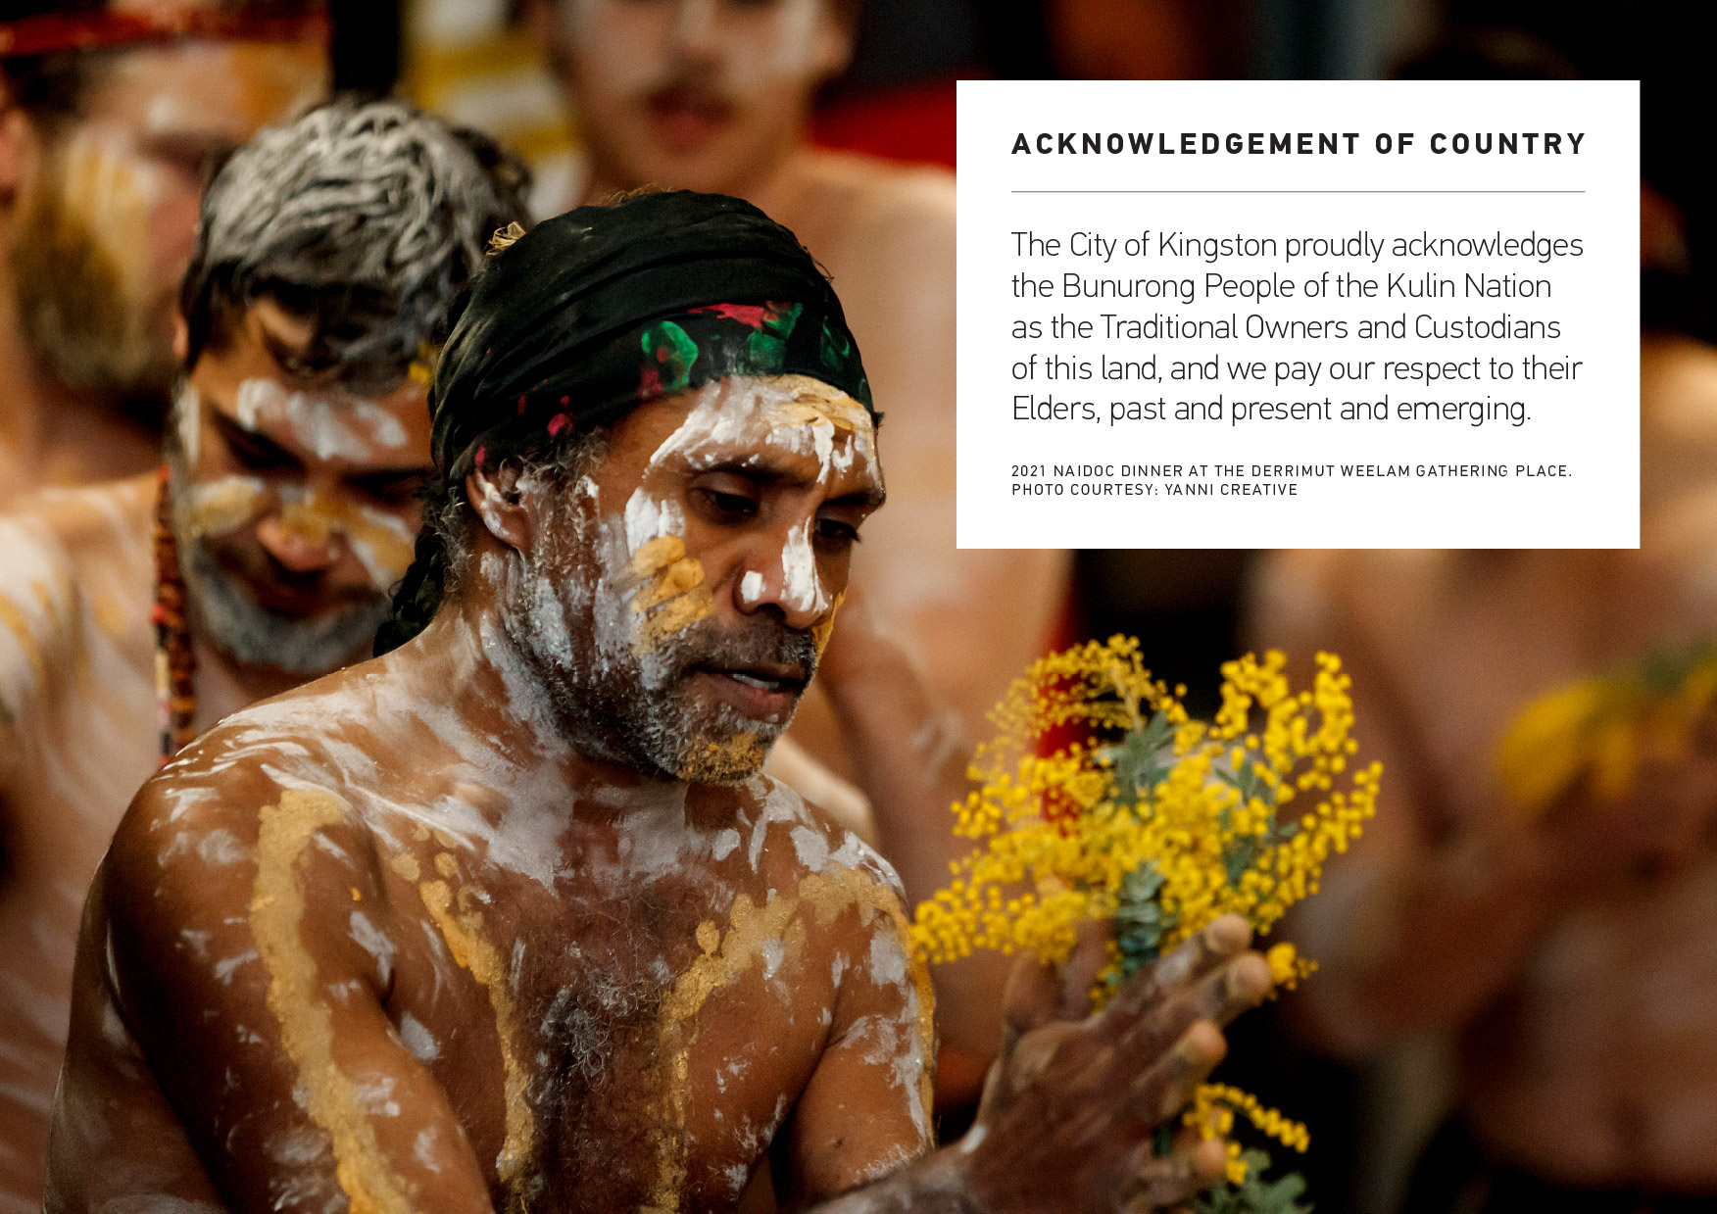
Acknowledgment of Country
The City of Kingston proudly acknowledges the Bunurong People of the Kulin Nation as the Traditional Owners and Custodians of this land, and we pay our respect to their Elders, past and present and emerging as well as any Aboriginal or Torres Strait Islander community members with us today.
Kingston’s official Acknowledgement of Country – there’s a powerpoint slide here you can use

Slide 4
Contents
Review of Kingston’s Grants
Kingston’s new grants program
Strategic alignment
Where to find information
Kingston Charitable Fund
Kingston’s Grant Program
How are grants assessed?
How to make an application via SmartyGrants
Application requirements
Successful applications
Why your application may be unsuccessful
Questions?

Slide 5
Grants Review
Key issues identified in the review:
Transparency & Good Governance
  Report back to Council and ratepayers
  Increased reporting metrics
  Scaled reporting to value of grant
Access & Information
  Knowing what grants are available
  Easy to understand application and assessment processes
  Support with applications
Equitable
  Ensuring funds are distributed equitably
  Supporting a greater diversity of applicants
Notes:
In some streams we are asking for additional info (scaled reporting).

Slide 6
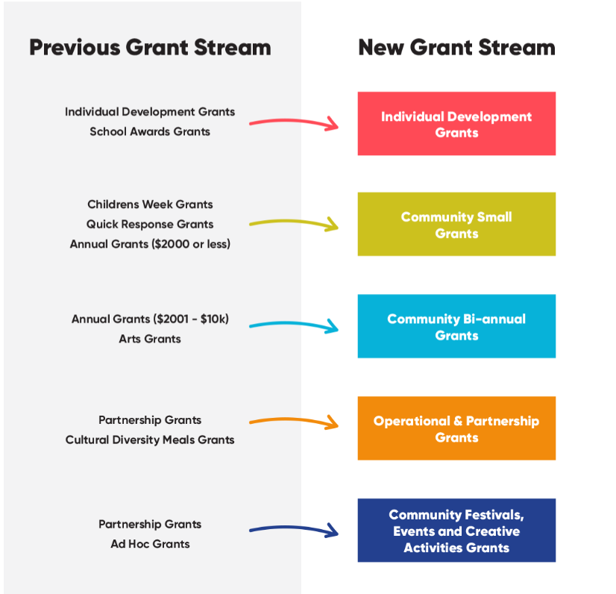
Kingston’s new Grants Program
Streamlined the grants into 5 new grant streams, plus the Kingston Charitable Fund

Slide 7

Council’s Strategic Aims
Council’s Aims
Liveable
Sustainable
Prosperous
Healthy & Inclusive
Safe
Well governed

Slide 8
Where to find information
Kingston Grants Program
www.Kingston.vic.gov.au/community/grants/grants-program
or search “Grants Program” on the homepage
Kingston Charitable Fund
www.Kingston.vic.gov.au/community/grants/Kingston-charitable-fund
or search “Kingston Charitable Fund” on the homepage

Slide 9


Slide 10
Kingston Charitable Fund - Overview
Purpose
The Kingston Charitable Fund aims to make the community stronger and more connected by supporting charitable organisations.
Who can apply?
Charities who benefit Kingston residents, and
Have Deductible Gift Recipient Item 1 status (DGR)
Have Tax Concession Charity status (TCC)
Funding
Each year the interest from donations received by the Lord Mayor’s Charitable Fund is given out to local charities (a total of approximately $70k per annum).
Key Dates
Applications open 29 January – 23 February 2024. Funding determined by June 2024.

Slide 11
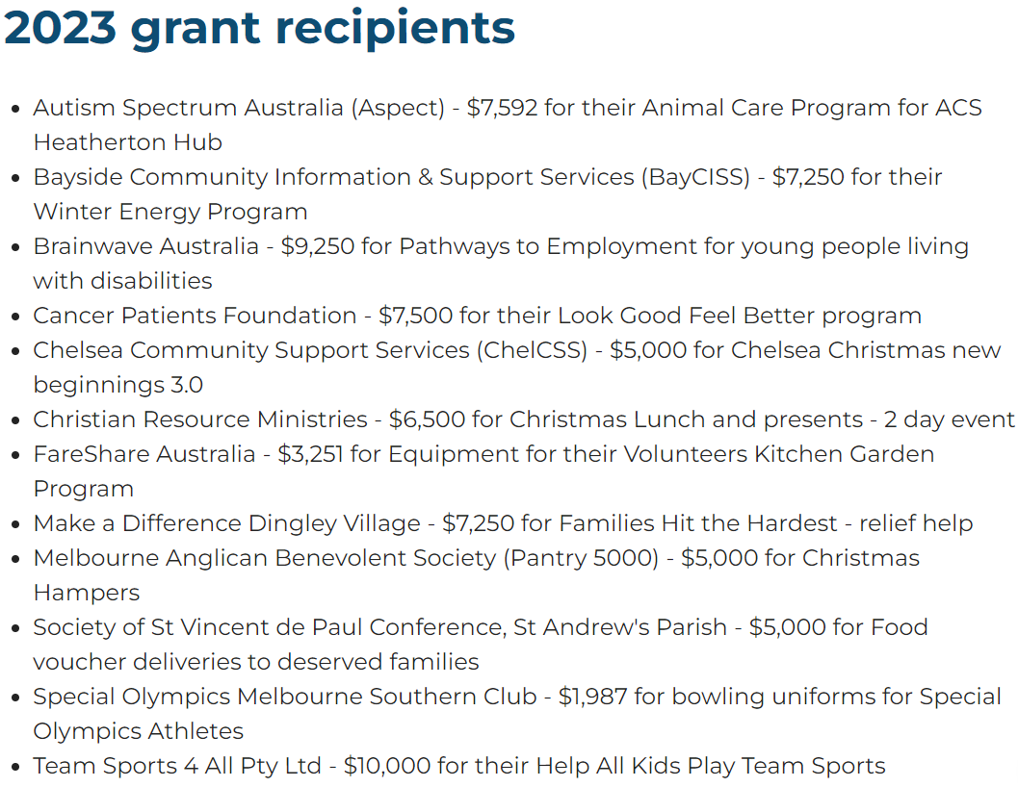

Slide 12
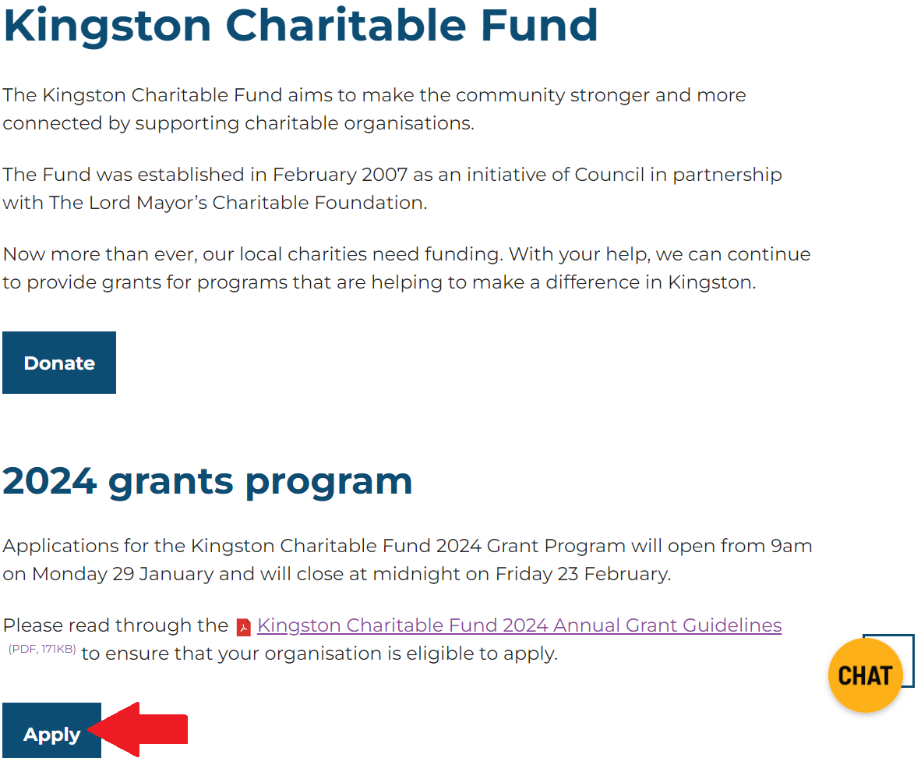
Kingston Charitable Fund - Where to apply

Slide 13
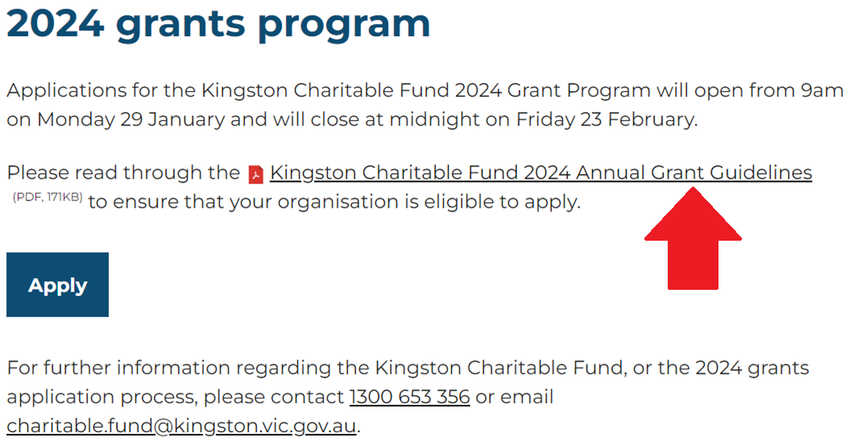
Kingston Charitable Fund - Guidelines

Slide 14
How are the Kingston Charitable Fund grants assessed?
Assessment Criteria:
  Community outcomes
  Link to planning
  Resources
Assessment Panel comprising of Mayor, Councillor, CEO & 2 Community representatives
Notes:
Kingston Council has appointed a KCF Grants Assessment Panel to assess and determine all applications for funding. The KCF Grants Assessment Panel comprises of the Mayor and one other Councillor, the Chief Executive Officer or their delegate and two community representatives. The Panel meetings are chaired by the Mayor or their delegate.

Slide 15


Slide 16
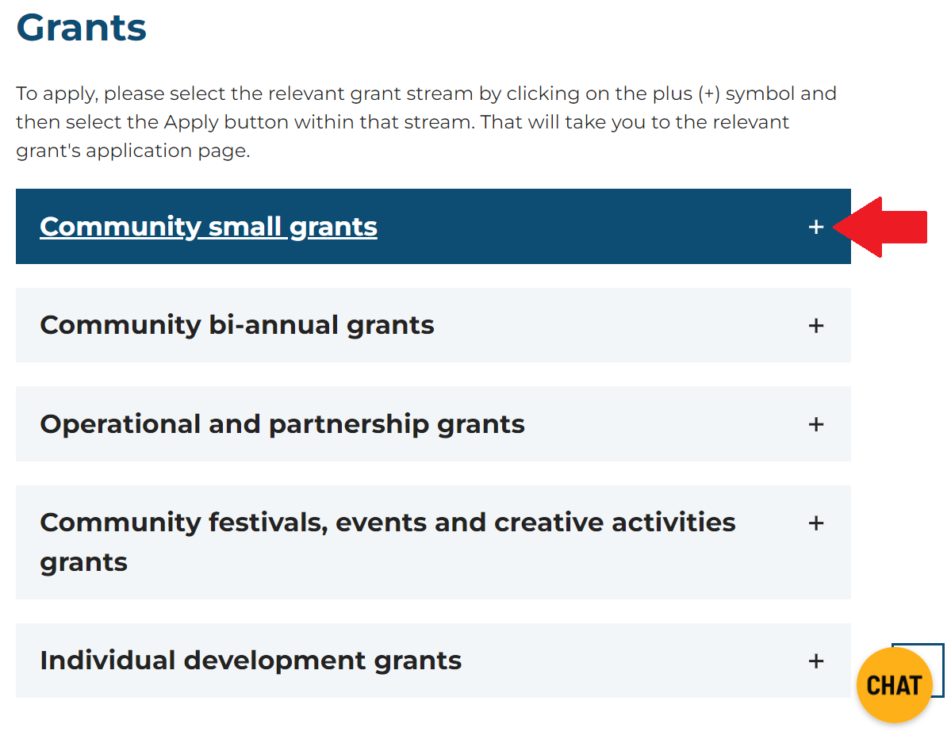
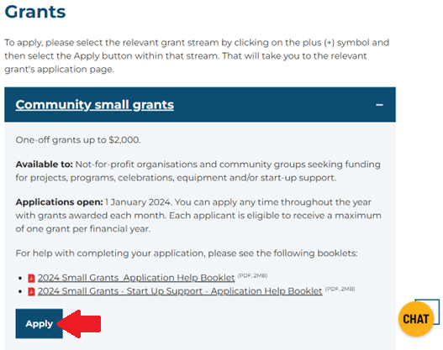
Kingston Grants Program - Where to apply
Click the grant stream to open for further information and to apply.

Slide 17
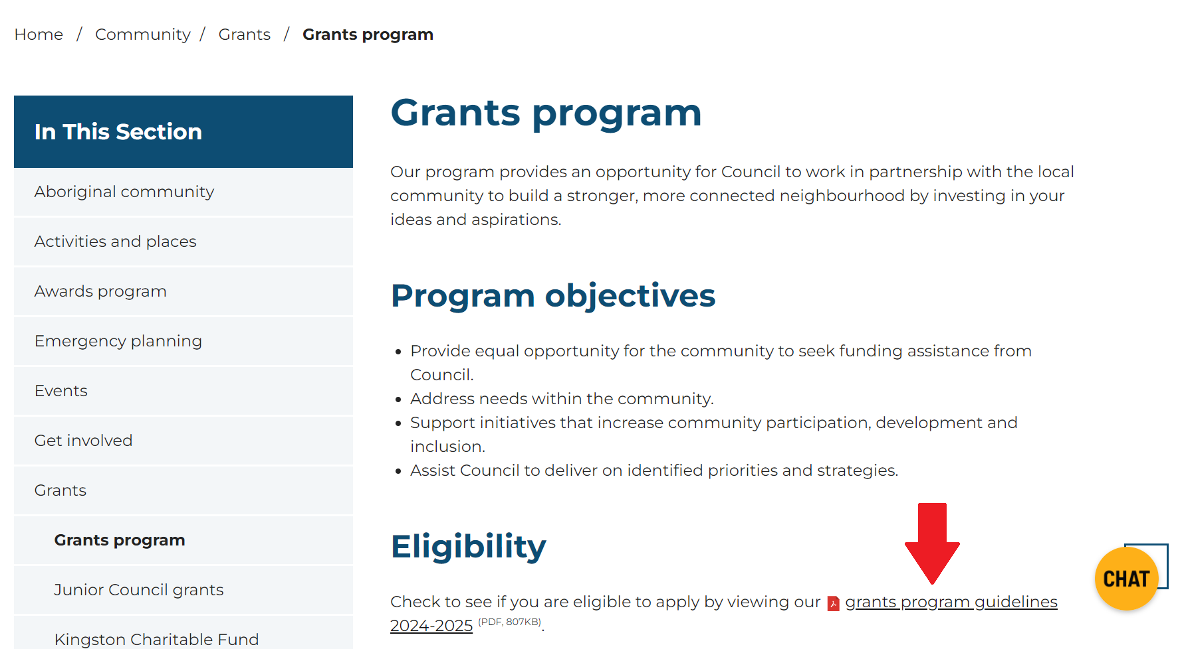
Kingston Grant Program - Guidelines

Slide 18
Individual Development Grants
Purpose
Achievement Category: To support individuals to compete, perform or represent at a State, National or International level in their chosen discipline; or
Participation Category: To support individuals experiencing financial hardship to access community institutions and clubs.
Who can apply?
Individual residents of Kingston
Categories & funding amounts
Achievement Category
$200 – State level within Victoria
$400 – National level held interstate or in Victoria
$600 – International level held overseas, interstate or in Victoria
Plus 25% financial hardship consideration
Participation Category
Must demonstrate financial hardship
Up to $600 per family
Key Dates
Always open. Assessed every 2-4 weeks until funding is exhausted. Each applicant is eligible to receive a maximum of one grant per financial year.
Notes:
Personal information is kept confidential

Slide 19
Community Small Grants
Purpose
To support smaller scale projects and activities that strengthen community participation, help the environment, improve group sustainability.
Who can apply?
Incorporated not-for-profit community groups and organisations or those auspiced by these organisations (Start-up Support category excluded)
Categories & funding amounts
All categories $0 - $2000
Categories
Community Projects & Programs
Community Celebrations
Small Equipment
Capacity Building
Start-up Support
Key Dates
Always open. Assessed every 4 weeks until funding is exhausted. Each applicant is eligible to receive a maximum of one grant per financial year.

Slide 20
Community Bi-annual Grants
Purpose
To support delivery of projects and activities aligned to Council’s strategic priorities.
Who can apply?
Incorporated not-for-profit community groups and organisations and artists; or those auspiced by these organisations.
Categories & funding amounts
All categories $2001 - $10,000
Categories
Community Projects & Programs
Small Community Festivals & Events
Minor Capital Works
Arts Projects & Programs
Key Dates
Round 1: 29 January – 11 March 2024; outcomes announced in July 2024
Round 2: 29 July – 6 September 2024; outcomes announced in December 2024
Each applicant is eligible to receive a maximum of one grant per financial year.

Slide 21
Community Festival, Event & Creative Activity Grants
Purpose
To support community event organisers to establish and deliver safe, successful, and sustainably operated festivals, events & creative activities.
Who can apply?
Incorporated not-for-profit community groups and organisations; or those auspiced by these organisations.
Categories & funding amounts
Up to $25,000
No categories
Key Dates
Triennial Funding Cycle 2024 - 2027 (3 years of funding for applications received in 2024, 2 years of funding for applications received in 2025, and 1 year of funding for applications received in 2026).
Apply 29 January – 28 March 2024 for 3 years of funding; outcomes announced in July 2024
Apply 29 March 2024 – end of March 2025 for 2 years of funding; outcomes announced in July 2025
Apply end of March 2025 – end of March 2026 for 1 year of funding; outcomes announced in July 2026

Slide 22
Operational & Partnership Grants
Purpose
To support provision and development of key community services, programs and other initiatives that align with Council’s strategic priorities.
Who can apply?
Incorporated not-for-profit community groups and organisations; or those auspiced by these organisations.
Categories & funding amounts
Multicultural & Seniors
  Formula Based: $1000 cap on regular social activities, $3000 cap on meals, plus a qualitative adjustment
Community Centres & Neighbourhood Houses
  Formula Based: Capped at $100k
Specialist Community & Welfare Services
  Merit Based: Capped at $90k
Community Interest Organisations
  Merit Based: Capped at 20k
Key Dates
Triennial Funding Cycle 2024 – 2027
Apply 29 January – 28 March 2024 for 3 years of funding; outcomes announced in July 2024
Notes:
Triennial Funding Cycle 2024 - 2027 (3 years of funding for applications received in 2024, 2 years of funding for applications received in 2025, and 1 year of funding for applications received in 2026).
Apply 29 January – 28 March 2024 for 3 years of funding; outcomes announced in July 2024
Apply 29 March 2024 – end of March 2025 for 2 years of funding; outcomes announced in July 2025
Apply end of March 2025 – end of March 2026 for 1 year of funding; outcomes announced in July 2026

Slide 23
How are grants assessed?
All grants are checked against the eligibility criteria prior to assessment
Individual Development Grants and Community Small Grants are assessed by our grants team
Community Bi-annual, Operational & Partnership, and Community Festival, Event & Creative Activity Grants are assessed against the criteria by relevant Council staff, then an Assessment Panel who makes recommendations to Council for their decision.

Slide 24
Assessment Criteria
Community Need
  What need your activity aims to address
  Audience of your activity
Community Benefit
  Alignment to Council’s strategic aims
  How will the activity benefit your audience?
  Support access, diversity & inclusion
Capacity to Deliver
  Project & Financial Planning
Capacity for Sustainability
  Will the project continue past the funding period?
Other Considerations
  Limited financial means
  Diversity of applications funded
See Guidelines for full details.

Slide 25
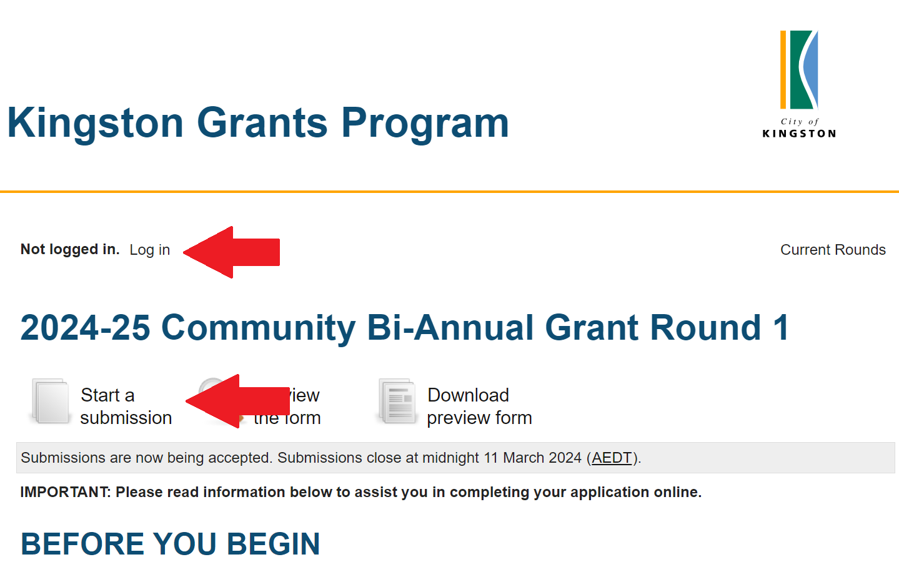
How to make an application via SmartyGrants
Applications are made via SmartyGrants
Log-in, then Start a submission
Application Help Booklets for each grant stream are available on Council’s website

Slide 26
Application requirements
Generally, applicants are required to provide:
Individuals must demonstrate they are Kingston residents
Organisations or groups are required to provide:
  Incorporation status
  Public Liability Insurance Certificate of Currency
  Annual Report or Financial Statement
  Child Safe Standards Policy (if applicable)
Applications for grants above $2,000 should be supported by evidence of community need/benefit; applicants capacity to deliver the activity; and quotes for expenses.
Applicants for larger grants are also required to identify how their activity aligns to Council’s goals and identify how they will measure the impact of their funded activity.
Notes:
Each grants category is different, so please read the Guidelines!
Generally, applicants are required to provide:
Individuals must demonstrate they are Kingston residents
Organisations or groups are required to provide:
Incorporation status
Public Liability Insurance Certificate of Currency
Annual Report or Financial Statement
Child Safe Standards Policy (if applicable)
Applications for grants above $2,000 should be supported by evidence of community need/benefit; applicants capacity to deliver the activity; and quotes for expenses.
Applicants for larger grants are also required to identify how their activity aligns to Council’s goals and identify how they will measure the impact of their funded activity.

Slide 27
Successful Applications
Once notified of a successful application, you will be asked to sign a funding agreement and provide a tax invoice for payment of your grant.
Grants awarded on an annual basis are required to provide an acquittal no later than 14 months after the grant is awarded.
Triennial grants are required to provide annual reporting and financial acquittals for the duration of their funding.

Slide 28
Why your application may be unsuccessful
Late or incomplete applications
Applicant or activity does not meet the eligibility criteria
Activity doesn’t align with Councils strategic aims
Application doesn’t demonstrate that the activity meets the assessment criteria
Unrealistic or not complete budget information
Poorly planned activities
Financial situation of the applicant (may be able to fund the activity themselves, or has debts owing to Council)
Ongoing or recurrent funding for same activity
All unsuccessful grant applicants will be provided with the reason their grant was unsuccessful.

Slide 29
FAQ
Can I apply for multiple grant streams, for example the Kingston Charitable Fund and the Community Bi-annual Grants?
  Yes, you can apply to multiple grant streams for different activities
Regarding grant streams that are always open, can I apply for more than 1 grant in a financial year?
  No, you can only apply for 1 grant per grants round/stream.
What do I do if my group/organisation doesn’t fit into a category?
  Contact us and we’ll let you know which category you should apply for

Slide 30

Questions

Slide 31
Further Support
Kingston Grants Officers
Phone Council: 1300 653 356
E: community@kingston.vic.gov.au
Grant writing workshop registrations
Notes:
If you require any support to know which grant stream to apply for, or assistance with your application, please contact Council’s Grants Officers

